Slide 1
Shared Purpose
Building a Strong Team Together
Notes:
INTRODUCTION
Purpose: This will explain the “why” or learning objective for each slide. This presentation has been created to help bring a team along on the journey to creating a shared purpose that they can all get behind and refer to regularly to guide their decisions as individuals and as a team.
Reminder: You will see reminders through out the presentation and you can use them depending on if you are facilitating in-person or virtually.
Materials: All the materials you will need have been outlined in the facilitation guide. These will be prompts about which materials you will need for which slide. Most applicable if you are facilitating in-person.
Speaking Notes: These are meant to guide you and be adapted to your situation and comfort level in facilitation. You can read them directly to the group or you can change it up.
Time: This will be the approximate time it should take you to facilitate a slide. Overall if you have 10 or less people, you could be able to facilitate this entire presentation in 1.5 hours. If you have 10 or more people you will likely need 2 hours to facilitate this presentation. If you are going to split up the time, please make sure you have at least 45 minutes to 1 hour for each session so people have enough time to get comfortable with each other. This can be a vulnerable experience because we are talking about values! Keep in mind that if the conversation is going well, be flexible and consider giving yourself more time and book a follow-up meeting to finish the slide deck. Its best not to rush it because the process is as important as the outcome of a shared purpose.
NB: Anytime you see square brackets [insert], this means you may want to add your own experience or the information included may not apply to your circumstance.

Slide 2
Getting to Know [Insert Your Technology]
[Adapt according to your virtual platform e.g. Zoom, WebEx]
Notes:
Purpose: Ensure that all participants feel comfortable using the digital platform (e.g. WebEx, Zoom) that you will be presenting on so that they will participate in the group discussions and activities.
Reminder: You will only need this is if you are going to be facilitating this shared purpose presentation online. Please tailor this according to the platform you are using – you may want to create a few more slides. If you can take snapshots of what you’re talking about and give people time to practice, this will support your team’s ability to engage in creating a shared purpose.
Speaking Notes:
Muting lines: for a group bigger than 10 people or if there is a lot of background noise, have everyone mute their lines and unmute to talk.
Chat box: where everyone can ask questions or share comments that may come up through out the presentation. Get people to practice by asking them a question. Don’t forget to check back on the chat box as you are facilitating.
Annotating: there are text and colour tools that people can use to write on the screen. If you want to use a whiteboard for people to write their answers, let them know what to use to write.
Time: 5 minutes

Slide 3
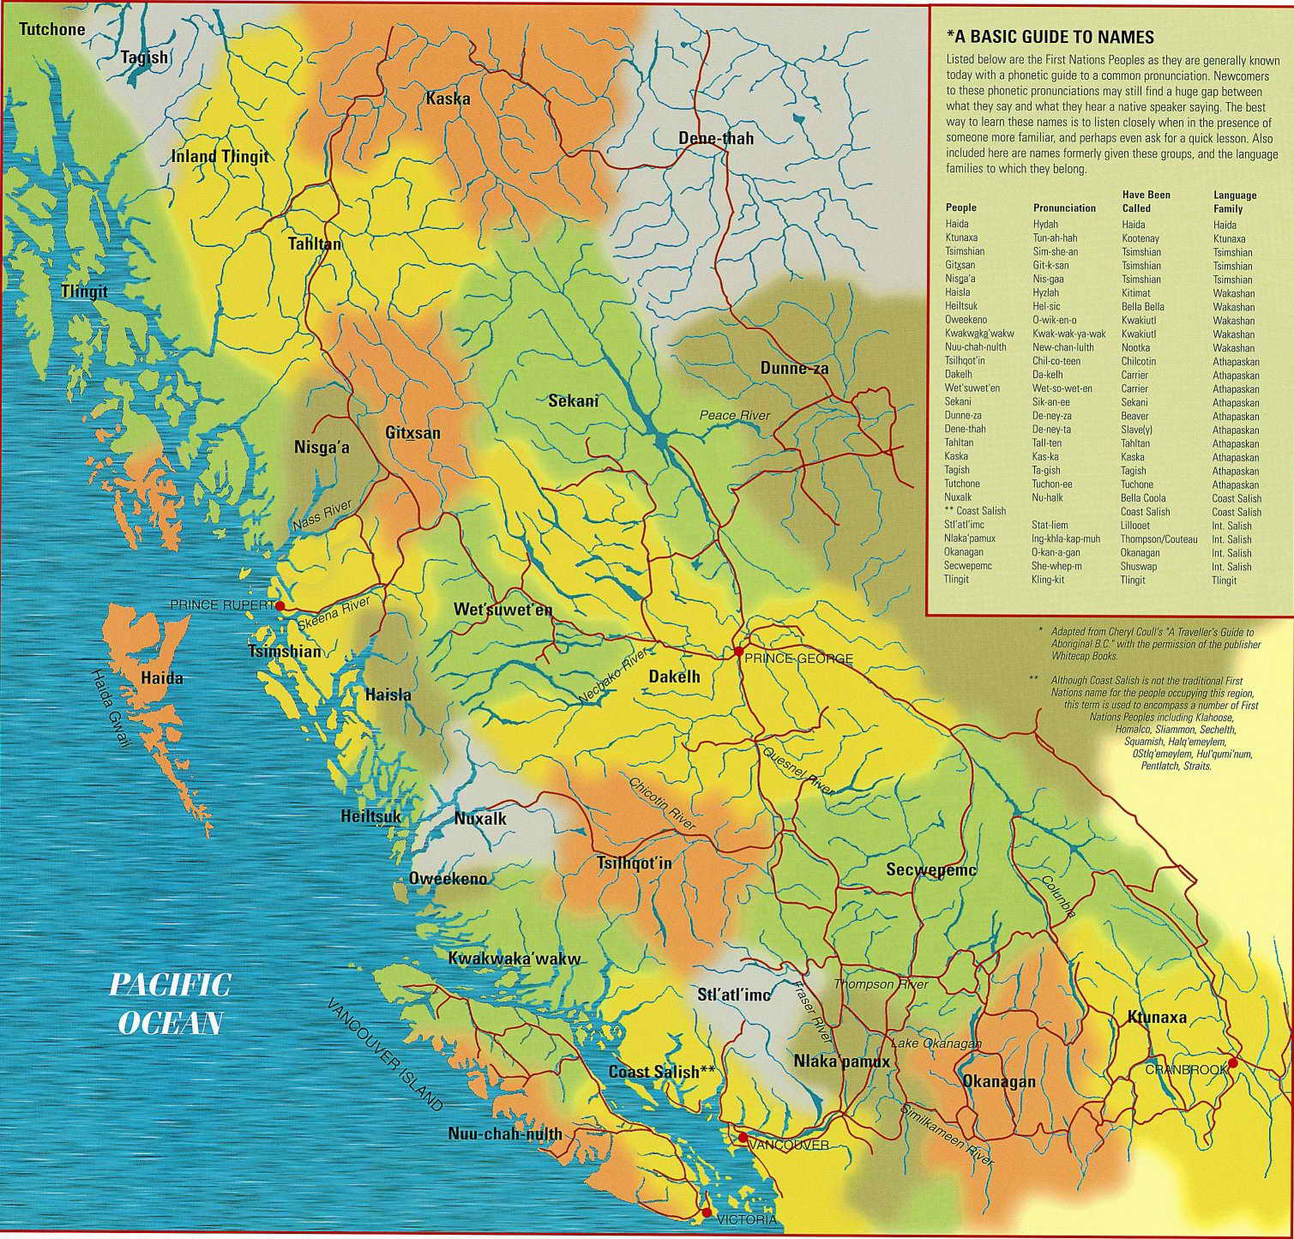
Territorial Acknowledgement
Notes:
Purpose: Start the meeting in a good way and ensure that all participants acknowledge the Indigenous lands that they have the privilege of working and playing on.
Reminder: If you are hosting a virtual session, your team members might be working and living on different lands. You can encourage them to write in the chat box which territory they are in or circle/put a stamp on the map.
Speaking Notes: I would like to begin by acknowledging the [respective] lands on which each of us is participating today. I’m located in [insert location] and would like to express my gratitude and acknowledge that I work and play within the ancestral, traditional and unceded territory of the [insert the name of the Indigenous peoples e.g. in Vancouver - xʷməθkʷəy̓əm (Musqueam), Skwxwú7mesh (Squamish), and səlilwətaɬ (Tsleil-Waututh) nations].
Time: 2 minutes

Slide 4
Agenda
Objectives (1 minute)
Check-in (5-10 minutes)
Importance of a shared purpose (5 minutes)
What’s included in a shared purpose (15-20 minutes)
Create our shared purpose (10-15 minutes)
Act on our shared purpose (10-15 minutes)
Next steps (10 minutes)
Notes:
Purpose: Provide a guide for what the team can expect to learn and do during the presentation.
Reminder: None.
Speaking Notes: Here is what we will be covering today [read the slide; if you are splitting creating the shared purpose into 2 meetings, let people know that here].
Time: 1 minute

Slide 5
Objectives
Describe the importance of developing a shared purpose as a team.
Identify individual values to inform and decide on team values.
Create a shared purpose statement as a team.
Plan how to apply and integrate your shared purpose into team activities.
Notes:
Purpose: Provide a guide for what the team can expect to learn and do during the presentation.
Reminder: None.
Speaking Notes: Here are the learning objectives for today. [If you feel comfortable, as a facilitator you could also ask: any questions about these learning objectives? Anything else you were hoping to learn?]
Time: 1 minute

Slide 6
Check-In
What’s your name?
What’s your role?
What’s one item you are proud of at work?
Principles for collaboration and participation
  Each person has voice and opportunity to participate in a meaningful way
  Each person has responsibility to give space for others to share and listen actively also know as the ‘step up/step back rule’
  What else do we need to feel safe to speak up?
Notes:
Purpose: Ensure that all participants know each others’ names and roles, to get an idea of what drives people on your team and creating a safer space for people to share their ideas.
Reminder: Having a quick check-in can help get the energy going for this group discussion. [Feel free to adapt the check-in question ‘what’s one item you are proud of at work?’ – could be any question you think would be helpful as an ice breaker or to get the conversation flowing]. Write on the slide any new principles the group thinks of.
Speaking Notes: It’s great to all be together in one space! [We have some new people on our team!] Each of us is going to introduce ourselves by saying our name and our role on the team, as well as one item that they are proud of at work. We are also going to go over some basic principles for collaboration and participation since we want everyone to feel as safe as possible in contributing their ideas. When thinking of the “step up/step back rule” I’d like each of you to reflect about whether you typically speak more or less at meetings and challenge yourself to do more of the opposite than you’re used to. I’d also like to hear about any other principles you’d like this group to respect (e.g., be present by not looking at your cellphone or let the group know if you need to step away for a few minutes).
Time: 5-10 minutes

Slide 7
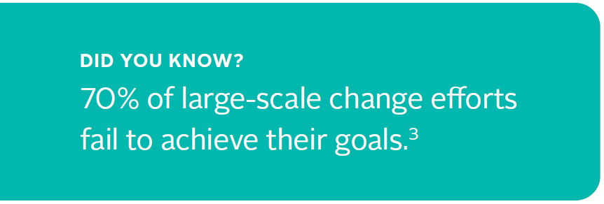
Why is Shared Purpose Important?
Shared purpose is what happens when a group of individuals align their belief systems or values with a common challenge, vision or goal.
It’s the “why” of change.
Enables a team to discover why a change is important to them and the work they do.
Notes:
Purpose: Ensure that meeting participants have a shared understanding of what shared purpose is and why its important.
Reminder: None.
Speaking Notes: The definition of shared purpose is: what happens when a group of individuals align their belief systems or values with a common challenge, vision or goal. It’s the “why” of change. Shared purpose is a critical driver of success in change. This is particularly true of large-scale change in complex systems such as the shift to an integrated system of team-based primary and community care. Shared purpose is a common factor in successful change and enables teams and communities to move off a plateau, re-energize and get enough people together to support the work that needs to happen. It also enables a team to discover why a change is important to them and the work they do.
Time: 1 minute
Reference: NHS – Shared Purpose Practical Guide

Slide 8
Our Organization’s Mission, Vison,
Goals & Values
[Insert your organization’s mission]
[Insert your organization’s vision]
[Insert your organization’s goals]
[Insert your organization’s values]
Notes:
Purpose: (Re)familiarize the team with your organization’s vision, goals and values, and reflect on how your shared purpose may connect or be different from those.
Reminder: Before this presentation, take some time to find out what your organization’s mission, vision, goals and values are (they may have one, some or all of these – use whatever is easily accessible to you). Your organization might also use guiding principles.
Speaking Notes: To make sure we are all on the same page and as a reminder about the whole organization’s [insert: mission, vision, goals and/or values] take a moment to read through them. Keep these in mind as we develop our shared purpose, which may or may connect and be different from them.
Time: 1 minute

Slide 9
What Shared Purpose is Not
Your organization’s mission, vision, goals or values
The “what” or the “how” of change
Notes:
Purpose: Differentiate between a shared purpose and organizational purpose as well as between “why” and the “what” and “how” of change.
Reminder: If you have time beforehand, it’s helpful as a facilitator to watch this 5 minute TED Talk by Simon Sinek called Start with Why (https://www.youtube.com/watch?v=IPYeCltXpxw) to be able to speak more to why knowing “why” is important to a team. Depending on how it resonates for you, you could also send this video out to your team or show it to them during your meeting.
Speaking Notes: You might be thinking, our organization has a mission, vision, goals and values. Creating shared purpose specific to your team or community is different from, and additional to, these. It's also not the “what” or the “how” of change, it's the “why”. I’d like to share an example with all of you:
We know what our clinic/health centre/other does to offer team-based care. Multiple health care providers from different professional backgrounds work together and with patients/clients, families, caregivers and communities to deliver comprehensive health services across care settings.
We know how our clinic/health centre/other offers team-based care. When a patient/client arrives at our clinic, [insert an example such as the medical office assistant always asks a few questions and depending on what the patient/client needs, offers for the patient/client to see their regular clinician and/or an allied health care professional more specific to their need(s).
However, neither the “what” or the “how” explains why this clinic/health centre/other has decided to work in a team-based care way.
Time: 2 minutes
Reference: Simon Sinek TED Talk

Slide 10
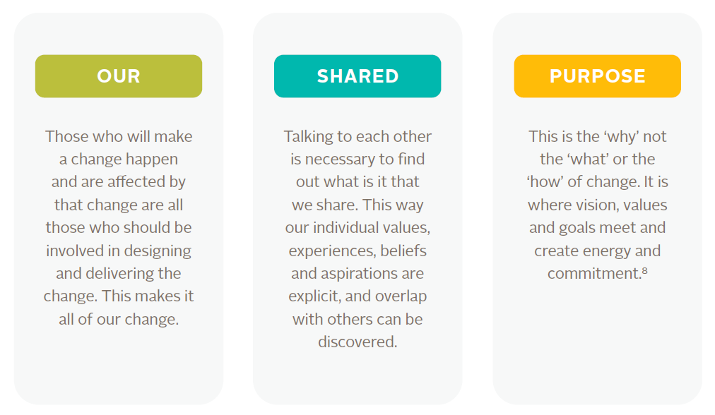
What Shared Purpose is
Notes:
Purpose: Understand what goes into articulating a shared purpose.
Reminder: None.
Speaking Notes: By building a shared purpose, it helps us tap into our need for meaningful work and to be part of something bigger than ourselves. Most change efforts involve collaboration between people with different knowledge, experiences and agendas. These differences can give us a richer and more complete picture of the truth and they can lead to conflict and prevent change from happening. It’s about finding common ground between values, beliefs and aspirations and working towards a common goal or vision. Here’s an example of the Provincial Team-Based Care Advisory Group’s shared purpose which has over 15 members from different organizations and another more general team example.
Time: 2 minutes
Reference: NHS – Shared Purpose Practical Guide

Slide 11
What Shared Purpose is
Examples of a shared purpose:
  To deliver quality1, person- and family-centred and collaborative care so that patients receive the right care, at the right time and in the right place, in a sustainable system with our values of effectiveness, appropriateness, respect, equity, efficiency, accessibility and safety at the core of what we do.
  To provide quality, person- and family-centered care every day with our values of teamwork, communication, compassion and honesty guiding us.
Notes:
Purpose: Understand what goes into articulating a shared purpose.
Reminder: None.
Speaking Notes: By building a shared purpose, it helps us tap into our need for meaningful work and to be part of something bigger than ourselves. Most change efforts involve collaboration between people with different knowledge, experiences and agendas. These differences can give us a richer and more complete picture of the truth and they can lead to conflict and prevent change from happening. It’s about finding common ground between values, beliefs and aspirations and working towards a common goal or vision. Here’s an example of the Provincial Team-Based Care Advisory Group’s shared purpose which has over 15 members from different organizations and another more general team example.
Time: 2 minutes
Reference: NHS – Shared Purpose Practical Guide

Slide 12
What is Team-Based Care and Why is It Important?
Patient/Client | Provider | System
Notes:
Purpose: Understand why the change (or current practice) to team-based care is important to the team members gathered.
Reminder: To encourage everyone to share, in-person you can have a ball and it gets thrown to a different person each time (people can always say pass or come back to me) or get everyone to write their ideas down on big sticky notes and place them in each category. Virtually, once someone goes they can pick the next person (again, people can always say pass or come back to me) or put their ideas into the table on the slide or in the chat box where you will then write them into the “right” category.
Materials: In-person, have this table on some chart paper, big sticky notes, pens and dots
Speaking Notes: Team-based care is when multiple health care providers from different professional backgrounds work together and with patients/clients, families, caregivers and communities to deliver comprehensive health services across care settings. Now let’s connect and share around the “why” behind team-based care, for our team. I’ve provided some broad categories of patient/client, provider and system to get us started. [Some examples - Sustainable systems, person-centred care, improved collaboration, better outcomes.]
---
What themes are people noticing? Let’s chat about it.
Now we are going to do something that some of you may be familiar with. We are going to do “dot voting”. It's a simple group activity for recognizing preferences among limited options.
Each of you will be given a set number of dot stickers [honesty rule applies if you’re virtual or everyone is using a pen].
You place the dot stickers next to options presented that you like.
The options with the most dots “win”.
Now take a minute to dot vote your top 5 areas that you think are the most important reasons behind moving towards change. So it looks like we have [insert the top 5 “whys”].
Facilitator Steps:
1- Get everyone to list examples of why team-based care is important into the 3 boxes. Someone might suggest another box and you could add it if the whole group agrees.
2- Get everyone to discuss and elaborate on the examples they chose and why they chose them.
3- Invite everyone to put a 5 dots beside their top 5 “whys”.
4- Circle the 5 values with the most dots (there may be ties! If so, you can always re-vote with the top 6-10 if the group feels there are too many)
5- Discuss why these choices are important to the team.
Time: 10 minutes total – 5 minutes to write on the table, 5 minutes to decide on themes.
Reference: Ministry of Health, Team-Based Care Policy Draft, 2020 July.

Slide 13
What Do You Value?
Integrity | Ownership | Innovation
Boldness | Constant improvement | Quality
Trust | Leadership | Teamwork
Accountability | Diversity | Simplicity
Patient-centred | Continuous learning | Fairness
Passion | Equity | Humility
Helpfulness | Cooperation | Responsiveness
Accountability | Partnership | Commitment to excellence
Respect | Flexibility | Inclusion
Notes:
Purpose:
Provide people time to reflect on their personal values.
Identify where personal values overlap and there are shared values across the team.
The overlap areas will be used to create a shared purpose.
Reminder: When facilitating virtually, have people identify their values first and then invite the team to discuss and explore where there is overlap[ (or shared values).
Materials: In-person, you will want to have this table written up on chart paper. You will also want to have dots or a marker for everyone to place their dots on the table that also has any values the team just added during the last slide.
Virtually, you will want this prepared list.
Speaking Notes: Values are basic and fundamental beliefs that guide or motivate attitudes or actions. Reflect on your own personal values and ambitions for the next minute. If you don’t see important values of yours on this table and you feel comfortable, please write them on the table.
Now that we have reflected and shared our personal values, discuss (or have people comment in the chat box) where you all see overlap in those values. I am going to circle where we see overlap!
Facilitator Steps:
1- Have everyone read through the list of values for one minute and think of any that might be missing.
2- Invite people to share any values that might be missing, either by writing them themselves or you write what they say.
3- Invite everyone to put a 5 dots beside their top 5 values.
4- Circle the 5 values with the most dots (there may be ties!
5- Discuss the values and why they are important to the team.
6- Validate with the team that these are the common vlaues.
Time: 12 minutes

Slide 14
Let’s Create Our Shared Purpose
We are united to achieve:
Through our values of:
Notes:
Purpose: Design the team’s shared purpose statement.
Reminder: This is going to take some brainstorming and “trying-out” different versions. You may decide as a team to sit on your shared purpose statement and come back to a next meeting with any ideas for changing it. Most important is that everyone agrees to any changes that are suggested. For those that are missing at a follow-up meeting, make sure to email them about the changes and get their approval as well.
Materials: If you are in-person, write this statement out on a piece of chart paper. You will want to have sticky notes and markers available.
Speaking Notes: How do our 5 “whys” and our values fit together. What do we want to achieve? With what values?
Facilitator Steps:
1- Revisit the themes that were important to the team for team-based care.
2- Invite people to come up with their version of what they are ‘united to achieve’ and put in the chat box or on sticky notes.
3- Input your values that were discussed before.
4- Try several different ways of saying it – you can always vote again on which statement the team prefers or come back to it at the next meeting.
Time: 10-15 minutes

Slide 15
How Will We Integrate Our Shared Purpose?
How are we engaging everyone on this team to achieve our shared purpose?
How are we listening and incorporating the perspectives of everyone on this team?
How are we as a team placing equal value on everyone our team?
Notes:
Purpose: Everyone on the team feels that they have a role in creating and acting on the shared purpose statement.
Reminder: Take notes to refer back to later or ask someone else on your team to take notes so you can focus on facilitating.
Speaking Notes: Let’s make sure that this is not something that just sits on the shelf. Shared purpose is something we should all feel a part of. Although this will be an on-going conversation, now’s the time to start thinking about how we want to integrate our shared purpose into what we do as a team. We are going to start by chatting through these 3 questions. To kick us off, let’s think of when new people join our team temporarily (e.g. locum) - how could they be introduced to our shared purpose?
Time: 10-15 minutes

Slide 16
Next Steps
Use our shared purpose to guide our work together
Move to action
Notes:
Purpose: Determine how, where and when the team will use the shared purpose to guide their work.
Reminder: Take notes to refer back to later or ask someone else on your team to take notes so you can focus on facilitating. If you are facilitating this virtually you can have your team go into breakout rooms as pairs or you can cut out the “pairing off” part of the activity and just have people think on their own and then share on a whiteboard or the chat box.
Speaking Notes: Now that we have created our shared purpose, where can we include it to keep it top of mind and as a guiding compass to our work as a team? Let’s do this using “think, pair, share”. So everyone take 1 minute to think about where we can include our shared purpose and how can we refer to it. Now create a pair by turning to a person next to you (or breaking off into a separate virtual room) and talk about your ideas. Then select one person in your pair to share back an idea or two with the group. Two examples to get you started – it could be added as a standing item to our meeting agendas and as a check-out, people could reflect on how well the meeting lived up to our shared purpose or when new priorities or programs come along, everyone asks themselves “how does [X] support our shared purpose?”. A shared purpose is not an approach to change where you get to “set-and-forget-it”.
Next steps & validation:
Thank you so much for being so open today – it was wonderful to collaborate with everyone. I am going to send out a follow-up email to everyone who participated and to those who missed the meeting and it will include the link to this slide deck, our co-created shared purpose statement, and support and integration ideas. Then I’d like to invite everyone to share further reflections on the shared purpose statement, support and integration via email, phone or in-person and discuss these at the next team meeting. I want to ensure I have accurately captured our team’s thoughts.
Facilitator Steps:
1- Invite everyone to self-reflect on the shared purpose and where it can be integrated.
2- Get people to pair up and share ideas. Get them to pick one person to report back to the group.
3- Share at least one idea with the group. Write down what they share.
3- Decide as a group what actions you want to take.
Time: 10 minutes

