Slide 1

Change Ambassador Network
Fraser Health Engagement Radicals

Slide 2
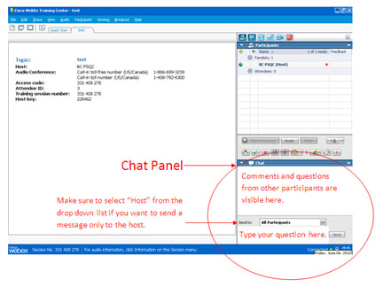
Webex: Chat Introductions
We invite you to introduce yourself in the chat panel.
Let us know your name and where you are from!

Slide 3
Can-BC
What is the Purpose of the Network?

Slide 4
Why Are We Here?
The Change Ambassador Network of BC was created to foster connections and support between individuals working to drive positive changes in the BC health care system.
The purpose of the group is to facilitate the spread of innovative ideas and transformation in the health care system, and provide opportunities for professional development and collaboration among members.
Notes:
Membership is open to everyone in BC. Members are invited to attend regular online meetings and participate in virtual and in-person learning opportunities.

Slide 5
Why Are We Here?
The Network was inspired by the volunteers who participated in the very successful Change Day BC, a 2015 campaign asking anyone involved in the health system to make one small change to improve care.
Network activities are coordinated by the BC Patient Safety & Quality Council.

Slide 6

Show of Hands!!
Did you participate in the Change Day BC Ambassador Calls?
How many of you are brand new to this?
How many of you receive the Change Ambassador Newsletter?
Notes:
Okay, using the hand button on the webex – bottom right hand side of the screen at the top of the chat box….
How many of you:
Participated in Change Day BC Ambassador Calls?
Are brand new to these calls?
How many receive the Change Ambassador Newsletter?
If you don’t receive it, you can sign up here….

Slide 7
Engagement Radicals
Ambassador Presentations

Slide 8
Fraser Health: Engagement Radicals
Carole Falkner
    Organizational Development Leader, Fraser Health
    Engagement Radical champion
Shelleylynn Gardiner
    Rehabilitation Assistant/Patient Safety Support- Emergency Dept
    Surrey Memorial Hospital, Fraser Health
    Engagement Radical

Slide 9


Creating the Engagement Radical Network
Engagement Team
Leadership & Organizational Development
Carole Falkner

Slide 10

Why & What
What we are Seeing
Our Learning

Slide 11


Slide 12

Call Out - Engagement Radicals
80 - June 2014
120 - Jan 2015
220 - March 2015
300 - Dec 2015
360 - Feb 2016
400 - June 2016

Slide 13


One who resists the status quo when
they see there could be a better way
Energize those around them by leading
from their true self
Engagement Radicals
Capable of working with others to create success
NOT a destructive troublemaker

Slide 14

Easy Access
E Team
Monthly Check-in Webinars
Newsletters, Question &
Resources
Feedback & Evaluation
Quarterly Face-to-Face Meet Ups
E Summit

Slide 15

Every Opinion MATTERS
Question of the Month (QOTM)
“How does working with others who are invested in their work encourage you in your work?
In pairs, small groups, huddles, white boards

Slide 16

“The Magic Wand”
Tool of the Month

Slide 17

Tool of the Month
Pack
up
Your
Troubles

Slide 18

Monthly
RAD Resource

Slide 19

Some caveats

Slide 20

Experience Stories
E-Rads @ Work

Slide 21
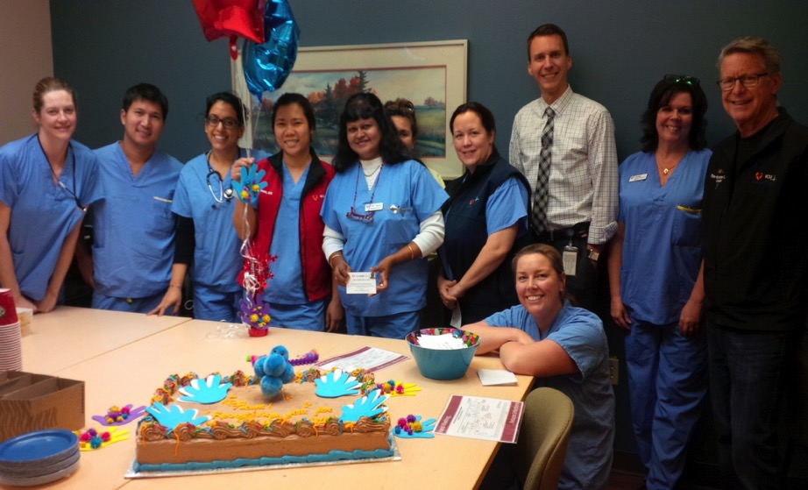
RCH - ICU Team Hand Hygiene
E Rad Recognition Celebration

Slide 22

Morning Huddles
Friday News
-One stop shop email summary

Slide 23


You can Change the World
When E Rads and E Rad Managers work Together

Slide 24



Slide 25




Engagement Radicals ‘Diaries’ Research Study
Preliminary Findings

Slide 26
Contrast: Experience of Worklife

Slide 27
significant difference
Note:
The midline of the graph is the normative level for health care providers.
Bars above the midline are good; bars below the midline are problematic.

Slide 28
Engagement Radical Impact?

Slide 29
Our Learning - Executive Support
We are committed; we want to see the Engagement Radicals expand. It is an important part of changing our culture and where we want to go in the future.
CEO Michael Marchbank
E Rads have made a huge difference- It really is about living “engagement begins with me”. People from all levels at the site taking responsibility for making this a great place to work. Ex Dir. RMH Kathy Doull
The E Rads bring a sense of caring, teamwork, support, joy to the site. I love that the E Rads demonstrate their commitment through action. Ex Dir. SMH Cathie Heritage

Slide 30

Our Learning

Slide 31
E Rad Voices
We can’t change the work or workload but we can “lighten” the
load with a positive work place and help people feel connected. Community Mental Health
Together with the other E Rads on my unit we brainstorm ideas on how to improve our unit moral and motivate people to find passion
in making a difference . Emergency Dept.
E Rads bring everyone together for the greater good. We bring a positive approach to different attitudes and provide encouraging
and inclusive values. MHSU
Being an E-Rad has enabled me to challenge myself and the rest
of our team about how we approach different challenges in the workplace. Emergency Dept.

Slide 32
“if you feel that these words describe you…consider you are an E Rad”

Slide 33
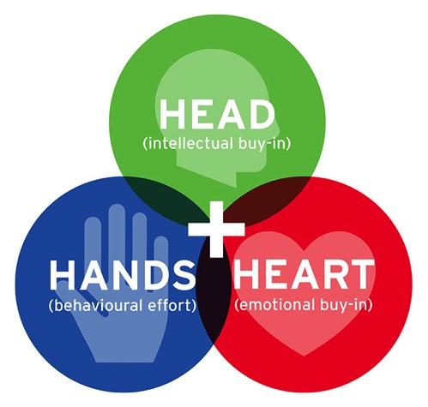

Developing a Site ERad network
SMH insights

Slide 34
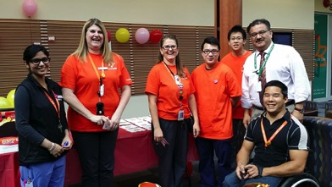
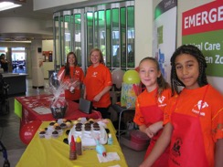
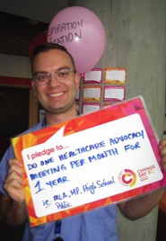
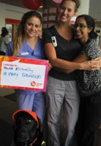
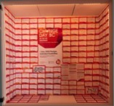
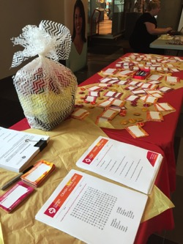
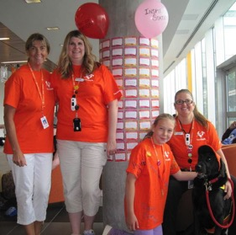
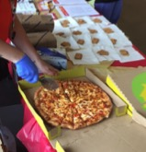
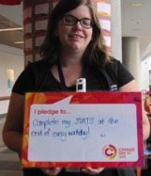
SMH Change Day 2015
Own your Success

Slide 35
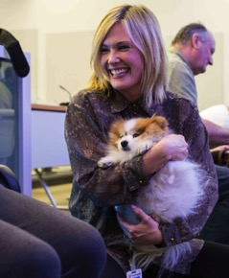
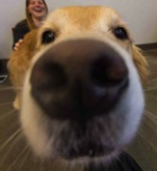
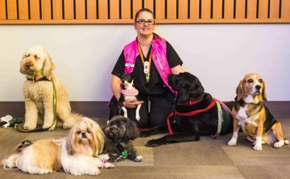
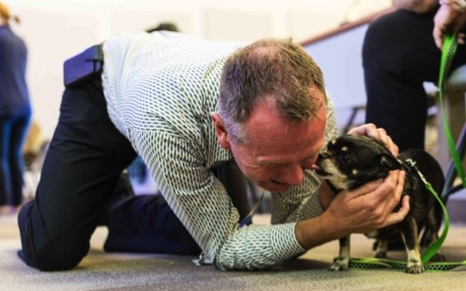
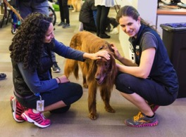
SMH Puppy Love Day
Determine your Core Values
Do-Learn-Modify-Repeat

Slide 36
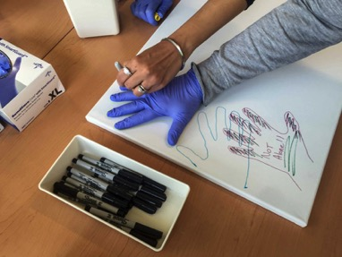
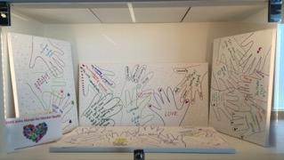
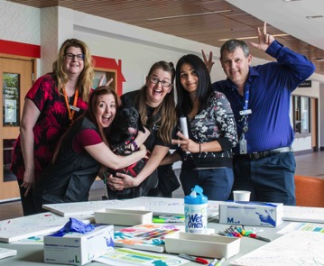
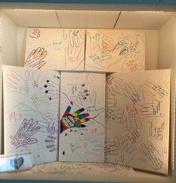
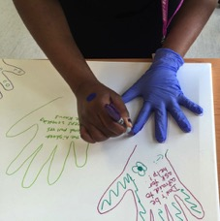
SMH Joins Hands for Mental Health
…celebrating Canadian Mental Health Week 2016
Be Brave
Shamelessly Borrow

Slide 37
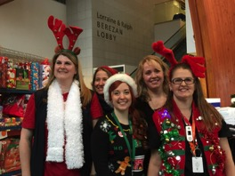
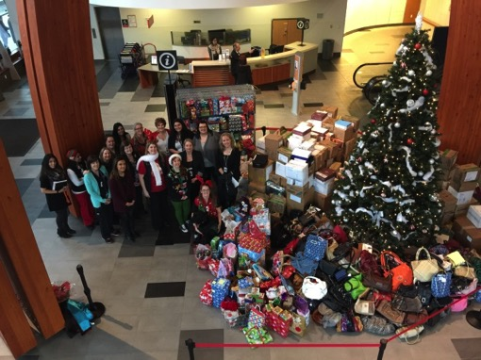
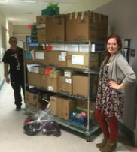
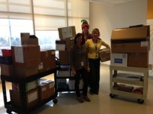

SMH Xmas Giving Campaign
Central Communication
Be Available

Slide 38
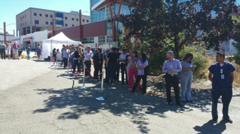
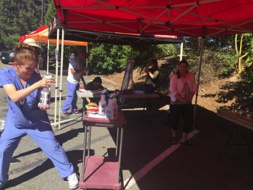
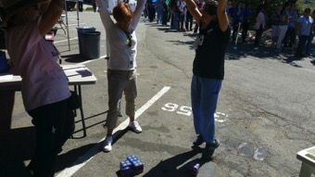
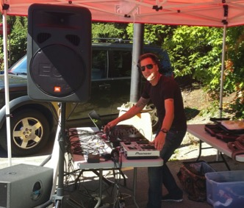
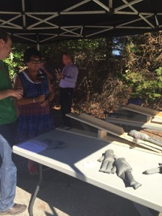
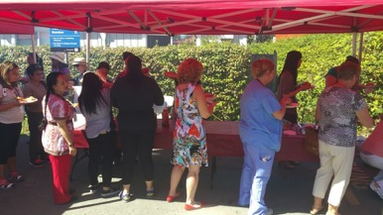
SMH Staff Appreciation BBQ
Gain Site Leadership support & build connections
Meet 2x a month

Slide 39
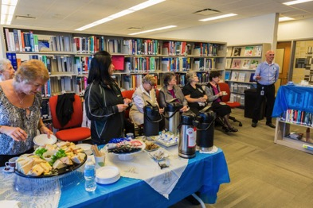
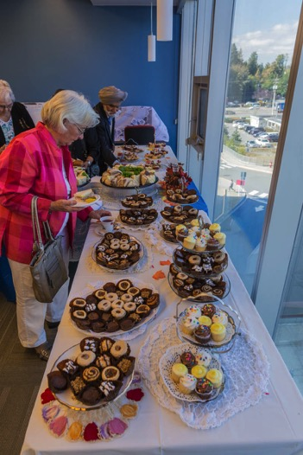
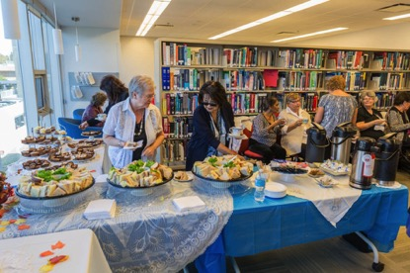
SMH Auxiliary Appreciation Tea
Seize Opportunities

Slide 40
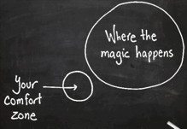
Developing a Site ERad network –SMH insights
Determine your core values
Shamelessly borrow
Gain Site Leadership support & build connections
Be available
Meet 2x a month
Do – Learn– Modify – Repeat
OWN your success
Seize Opportunities
Be Brave
Central Communication
One Leader
Creative & Driven
Time & Patience
Motivator
If you do not GO after what you want,
You’ll never have it.
If you do not ASK,
The answer will always be NO.
If you do not STEP FORWARD,
You’ll always be in the same place.

Slide 41
Engagement Radicals
Questions/Discussion

Slide 42
CAN-BC
What’s Next?

Slide 43
Next
CAN-BC Breakfast Session at the Quality Forum Conference
  Meet others involved/interested in the Network
  Start your day learning and connecting with others
Notes:
Calling all change agents! Do you want to develop the skills to drive improvement and transformation in health care? Want to meet others with a passion for positive change? Start your day by learning about the purpose and upcoming activities of the Change Ambassador Network of BC, and connecting with kindred spirits from across the province at this informal networking breakfast

Slide 44
Future Webinars
Next call: Tuesday, February 14, 2017
  Come share a little love and learning on Valentine’s Day with Sonya Chandler from Island Health
  Learn more about June’s ‘What Matter’s To You? Day’ Campaign!!

Slide 45
Future Webinars
Webinar topic poll
Want to present at a future session? Let us know in the chat box or e-mail ckennedy@bcpsqc.ca

Slide 46
EvalUation

