Slide 1


LOW-CARBON, HIGH-QUALITY CARE COLLABORATIVE
Information Sessions
November 2 & 3, 2023

Slide 2


Territorial Acknowledgement
sḵwx̱wú7mesh úxwumixw (Squamish)
xʷməθkʷəy̓əm (Musqueam)
sel̓íl̓witulh (Tsleil-Waututh)
Map by Deborah Reade
Notes:
Intro (2 min):
Welcome and introduction
Territorial Acknowledgement
Invite participants to introduce themselves and where they’re joining in from

Slide 3





Our Partners
Notes:
Cascades Canada is a leader in sustainable health care practices across Canada –
CASCADES is an initiative of four founding partners: the University of Toronto Centre for Sustainable Health Systems, the Healthy Populations Institute at Dalhousie University, the Planetary Healthcare Lab at the University of British Columbia, and the Canadian Coalition for Green Health Care. Funded by Environment and Climate Change Canada
They have a missions to strengthen the capacity of the healthcare community across Canada to transition towards, high-quality, low-carbon, sustainable and climate resilient care.
Vancouver Coastal Health – partnering with Andrea MacNeill, the Regional Medical Director for Planetary Health and her team. Many of you may know Andrea for her advocacy and passion to both understand and improve the health systems impact on climate change.

Slide 4

Agenda
Low-Carbon, High-Quality Care (LCHQ) Collaborative Overview
  What is LCHQ?
  Collaborative Model Overview
  Why focus on Climate Conscious Inhalers and Perioperative Practices?
  Aims and Drivers
Action & Improvement Team Recruitment
  What can teams expect?
  Who can participate?
  Application process
Q&A and closing
Notes:
Overview of agenda (2 min)
Notes:
LCHQ Care Collaborative Overview (~20 min)
What is LCHQ? 5 min
Why focus on LCHQ Care ? 3 min
Aims & Drivers 5 min
Collaborative Model Overview 5 min
Team Recruitment (~10 min)
What can teams expect? 3 min
Who can sign up? 5 min
Application process 3 min
Questions and closing (~25 min)

Slide 5

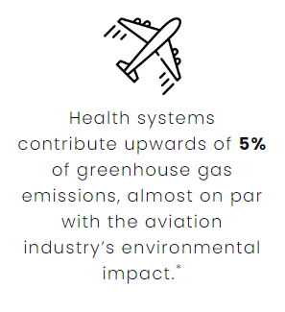
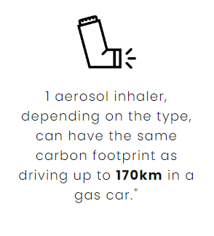
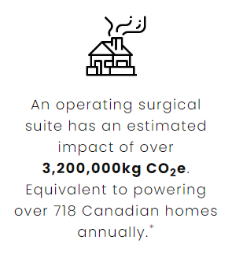
DID YOU KNOW?
Notes:
Health care’s impact on contributing to worsening environmental impacts
Identified that medications and operating rooms are some of the most carbon intensive aspects of care delivery

Slide 6

  Goal to spread and scale up efforts across the province and share knowledge of low-carbon clinical practices that improve the quality of care
Notes:
Collaborative Overview: (5 min)
- This work will be spearheaded by HQBC’s LOUD in PC project team, with guidance for content (including a change package), coaching, evaluation and more provided by expert faculty from across the health system.
How we are going to do this: next slide –

Slide 7

Collaborative Model Overview
What is the “collaborative” model?
A model for quality improvement initiatives that is adapted based off the Institute for Healthcare Improvement’s (IHI) Breakthrough Series
Experts with content and context experience identify key drivers and change ideas around emerging and evidence-informed subject matter
Teams are recruited and united around a common aim
A network of teams from different communities all work on the same challenges together
Promotes peer-to-peer learning and identifies best practices
Notes:
Collaborative Overview: Collaborative Model Overview pt 1 (2 min)
This model is designed to support the spread and implementation of new or better clinical practices.
LCHQ Care is expected to span primary care settings across BC, with
Teams from different communities and acute and primary care settings all working towards a similar aim at the same time, focusing on their specific strengths and needs
Learning sessions to provide learning content from speakers and experts
Team meetings to help you decide what changes you want to try out as you work towards improving LCHQ Care in your care setting
Coaching and learning sessions to allow teams to learn from each other's experiences and champion effective changes across regions

Slide 8
Why focus on Climate Conscious Inhalers and Perioperative Practices?
Foundational work in these two clinical practice areas:
Practice changes in the two areas have a strong link to quality
Supported by CASCADES playbooks outlining impacts, action areas, change ideas, measurement strategies and resources
Clinical champions here in BC to help support the work
Uptake of clinical teams already embarking on making changes in these areas – opportunity to come together to accelerate changes
Notes:
Why focus on Climate Conscious Inhalers and Perioperative Practices? (3 min)
Foundational work done in these areas – based on Cascades playbooks, many ppl already doing work in this areas so an opportunity to bring people to work together
The two areas also have a strong link to impacting quality of care – (next slide) -

Slide 9
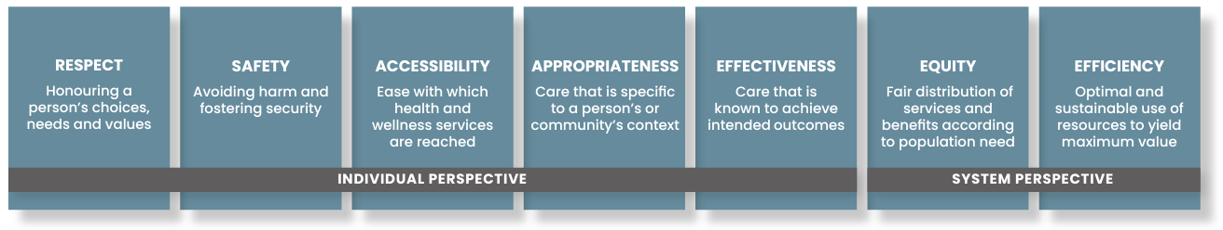
Dimensions of Quality
Defining quality in British Columbia
https://healthqualitybc.ca/resources/bc-health-quality-matrix/
Notes:
This is how we define quality here in BC
Some key areas are appropriateness and efficiency but also respect

Slide 10

Aims and Drivers
The collaborative will aim to:
Spread and scale up efforts across the province and share knowledge of low-carbon clinical practices that improve quality of care.
Drivers * just a few examples – many change ideas to support the work *
Climate Conscious Inhalers | Sustainable Perioperative Practices
Appropriate prescribing practices Ex: confirming dx of asthma and COPD with spirometry | Optimize efficiency: Ex: Patient education regarding benefits of regional blocks
Encouraging sustainable alternatives Ex: patient education and awareness, prescriber education and awareness | Reduce emissions: Ex: Removing desflurane vaporizers from the anesthetic machine
Notes:
LCHQ Care Collaborative Overview: Aims and Drivers (5 min)
These are just a few of the drivers and change ideas – we are happy to explore other change ideas or clinical practices that you might have ideas around

Slide 11



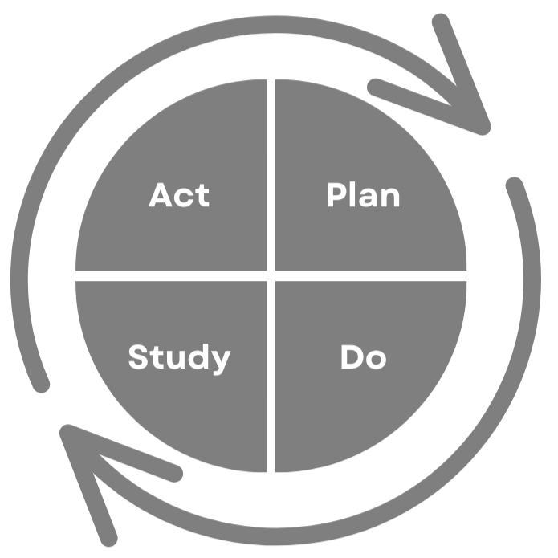


What can teams expect?
Collaborative Teams are Formed
Complete Pre-work
Virtual Kick Off
Learning sessions
Coaching calls
Virtual Celebration
Improvement cycles
Event | Timeline
Team Recruitment | October – November 2023
Team pre-work: aim, focus, measure | November -December 2023
Four virtual learning sessions | January 2024 – October 2024
Six coaching calls | January 2024 – October 2024
Virtual closing | October 2024
Evaluation | October 2024 onward
Notes:
Action & Improvement Team Recruitment: What can teams expect? (3 min)
After teams have formed, participants will:
Identify their aim, focus and measurement through pre-work in November and December
Receive a robust toolkit (a Change Package) full of change ideas, quality improvement methodologies and clinical resources to guide practice changes in the two streams and
attend four virtual learning sessions and six coaching calls between January 2024 and October 2024;
Meet with their project teams monthly and submit a progress report
have access to a faculty of subject area experts and mentors from across the province to help implement new practices in a variety of settings;
be grouped together with other teams who are making similar changes in similar settings for peer-to-peer learning and support;
be provided with a user-friendly measurement plan will be included with suggested measures for teams to track their improvement efforts and impacts
Dates of the learning sessions: January 24, Feb. 28, May 8 and Oct. 9, 2024 – 3 hour learning sessions -

Slide 12

Who can participate?
Anyone interested in reducing health care’s environmental footprint!
New to or seeking to learn more ways to decrease environmental costs while delivering care
No previous experience with quality improvement or of low-carbon practice changes
Teams of ideally 4-7 people within your clinical setting
No charge to participate
Notes:
Action & Improvement Team Recruitment: Who can participate? (5 min)
Anyone who is interested in improving health care’s carbon footprint! The one-year collaborative, starting January 2024, is designed for physicians, nurse practitioners, respiratory therapists and hospital pharmacy teams with their clinical teams: MOAs, pharmacists, allied health, and community services that support the delivery of care. Whether you are looking to start providing low-carbon practice changes for the first time or expanding your current low-carbon practices, participating in LCHQ Care can accelerate those efforts through access to clinical and quality improvement expertise, peer-to-peer learning and mentorship, and curated resources.
Your project team can include any combination of people you would like! Four to seven members is ideal. Suggested minimum is 3.
Teams should have the authority to make decisions for the clinical setting or have the support of decision makers.
No previous experience with quality improvement of low-carbon practice changes is required, and no charge to participate. If you’re interested in providing low-carbon practice changes for the first time, it might feel scary with lots of uncertainty at first. Mentorship helps with this! The collaborative will offer this mentorship as well as supports for creating a new, sustainable flow. You can learn from people who have been in similar shoes and not have to reinvent your own wheel.

Slide 13

Application Process
Applications now open on the HQBC website
Team application calls
APPLY BY NOVEMBER 24!
Notes:
Action & Improvement Team Recruitment: Application process (3 min)
There is no charge to participate in the collaborative.
We’ll be doing team application calls with teams who apply to get a better understanding of the clinical practice changes they want to make.

Slide 14
Contact Us!
Low-Carbon, High-Quality Care lowcarbon@healthqualitybc.ca

