Slide 1
*Insert team name*
Teamwork Agreement
*insert date*

Slide 2
Concerts
*insert photo’s of your team doing something they love*
Friends
Baking
Travel
Food
Hiking
Notes:
5 Things High-Performing Teams Do Differently
Hint: It’s not always about the work. by Ron Friedman
Harvard Business Review Article from October 2021
https://hbr.org/2021/10/5-things-high-performing-teams-do-differently
chrome-extension://efaidnbmnnnibpcajpcglclefindmkaj/https://cdn.fedweb.org/fed-115/2/Final%25205%2520things.pdf
2021 research article suggests that the highest-performing teams have found subtle ways of leveraging social connections during the pandemic to fuel their success.
It’s more than simply hiring the right people and arming them with the right tools to do their work.
It requires creating opportunities for genuine, authentic relationships to develop.
The authors present five key characteristics of high-performing teams, all of which highlight the vital role of close connection among colleagues as a driver of team performance.
Article talks about when it comes to building extraordinary workplaces and high-performing teams, researchers have long appreciated that three psychological needs are essential: autonomy, competence, and relatedness.
Decades of research demonstrate that when people feel psychologically fulfilled, they tend to be healthier, happier, and more productive.
High-Performing Teams Are Not Afraid to Pick Up the Phone
High-Performing Teams Are More Strategic With Their Meetings
High-Performing Teams Invest Time Bonding Over Non-Work Topics
High-Performing Teams Give and Receive Appreciation More Frequently
High-Performing Teams Are More Authentic at Work (vulnerability, humour, emojis, memes)

Slide 3
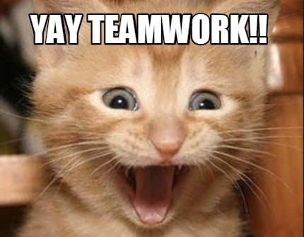
Teamwork Agreement
The “Why”
The “What”
The “How”
Notes:
When team members knows what is expected of them and how they work together to become a high performing competent team, they are much more effective
Creating a teamwork agreement helps team understand the why we do what we do as a team, the what we do as a team and the how we do it as a team, including how we resolve conflict
STEPS:
-Go through slides, gather information and then take this information and put it into a teamwork agreement.
-Send teamwork agreement out to everyone for validation and feedback.
-Schedule another time, approximately 30 min to review and reflect teamwork agreement, make any changes and discuss implementation and sustainability strategies.

Slide 4
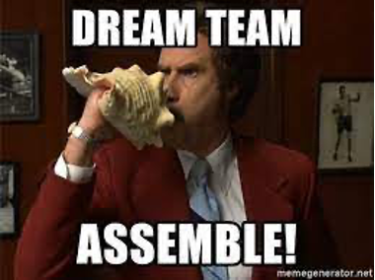
What is the best team you’ve ever worked on?
What made it so exceptional?
Notes:
In person:
Use flip chart and sticky notes
Virtual:
Put question in chat
Have participants use chat or text tool

Slide 5
Values and Ambitions
Who are we as individuals and as a team?
INDIVIDUALS
Notes:
In person:
Use flip chart and sticky notes
Virtual:
Put question in chat
Have participants use chat or text tool
Individual values and ambitions – list your top 3
Have team vote for their number one value and ambition and then take the top 3 votes to identify the top values and ambitions as a team
Facilitator to circle top votes

Slide 6
Why do we do this work?
Notes:
In person:
Use flip chart and sticky notes
Virtual:
Put question in chat
Have participants use chat or text tool

Slide 7
Reflection and Discussion
How are we engaging everyone on this
team to achieve our shared purpose?
Notes:
Thinking about what we just discussed with values and ambitions…how are we engaging everyone on this team to achieve our shared purpose?
In person:
Use flip chart and sticky notes
Virtual:
Put question in chat
Have participants use chat or text tool

Slide 8
Reflection and Discussion
How are we listening and
incorporating all perspectives?
Notes:
In person:
Use flip chart and sticky notes
Virtual:
Put question in chat
Have participants use chat or text tool

Slide 9
Reflection and Discussion
How are we placing value on everyone within our team?
Notes:
In person:
Use flip chart and sticky notes
Virtual:
Put question in chat
Have participants use chat or text tool

Slide 10
What factors or qualities make us effective as a team?
Notes:
In person:
Use flip chart and sticky notes
Virtual:
Put question in chat
Have participants use chat or text tool

Slide 11
What factors or qualities have (or will) challenge us as a team?
Notes:
In person:
Use flip chart and sticky notes
Virtual:
Put question in chat
Have participants use chat or text tool

Slide 12
How do we want to resolve conflict?
Notes:
In person:
Use flip chart and sticky notes
Virtual:
Put question in chat
Have participants use chat or text tool

Slide 13
How do we want to have fun as a team?
Notes:
In person:
Use flip chart and sticky notes
Virtual:
Put question in chat
Have participants use chat or text tool

Slide 14
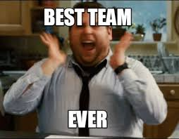
Next Steps
Draft Teamwork Agreement and share with team
Discuss implementation and sustainability plan

