Slide 1
All About Me Template

Slide 2
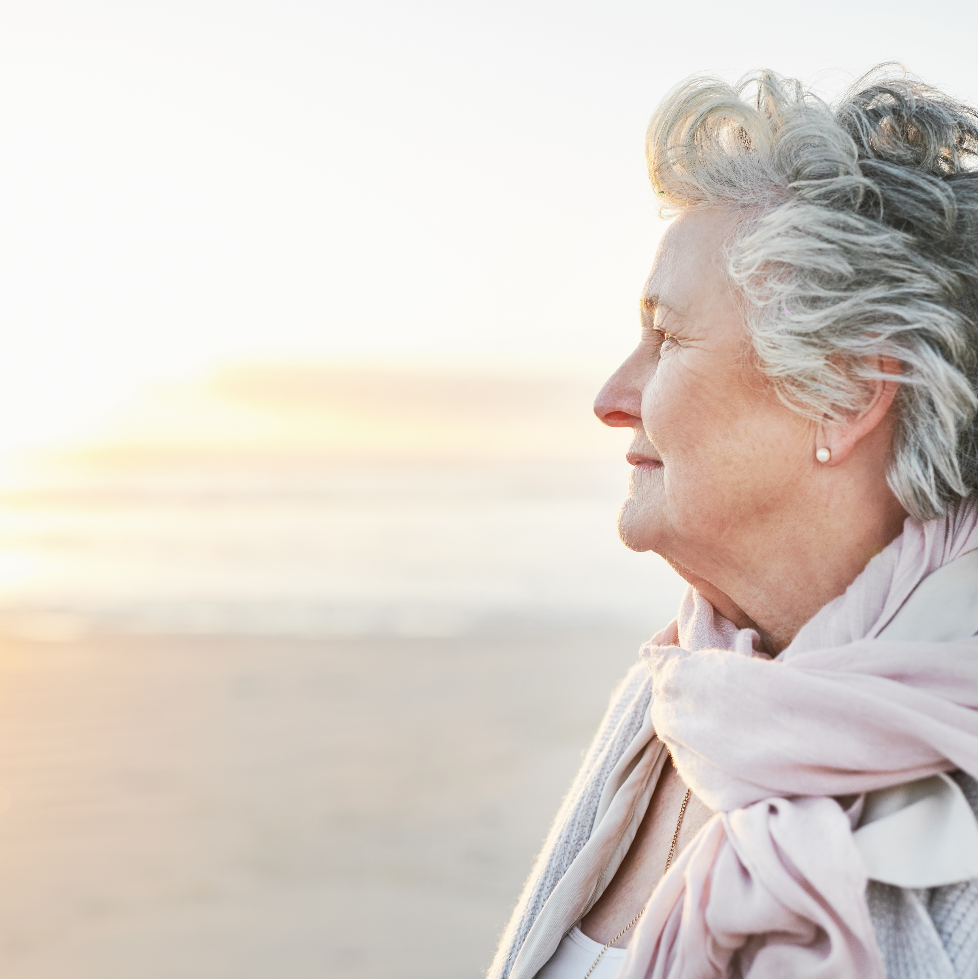
Betty Rose Parker
About me…I have lived near the ocean all my life. I attended nursing school in 1985. I am married and have two sons.
Hobbies & Interests
I love to garden and go for walks.
What I like to do now…..I like to listen to music and spend time outside.

